Slide 1
project FAT CAT
Presented by Team Ocean’s 11:
Aditi Bhatia
Arshdeep Singh
Dipro Chowdhury
Dishant Kimtani
Suhel Mehta

Slide 2
An overview
Inspired by “Mario” and lazy cat videos
Written in JavaScript and built using MelonJS
Structured with 5 design patterns
Main objective: avoid obstacles and finish all levels as fast as possible for a highest possible score.

Slide 3
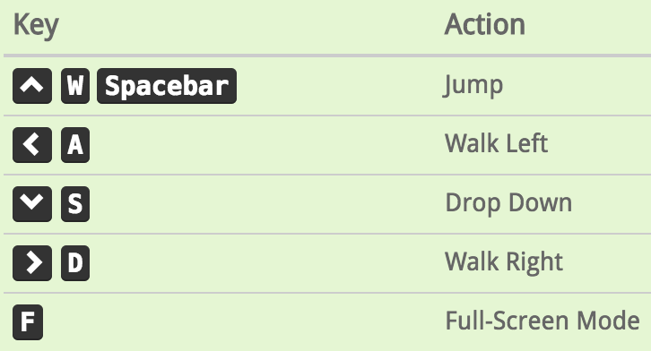
Fat CAT: How to play
All movement is mapped to the up, down, right, left, and spacebar keys
Press the up button multiple times to jump higher.
Should avoid unhealthy food items: pizza and hamburgers.
Reduces character speed, health and lowers score.
Should eat healthy food items: apples and spinach.
Increases character speed, health, and increases score.
Must avoid all obstacles (river, metal spikes, holes) which kill the character and end the game.
Main objective: avoid obstacles and finish all levels as fast as possible for a highest possible score.

Slide 4
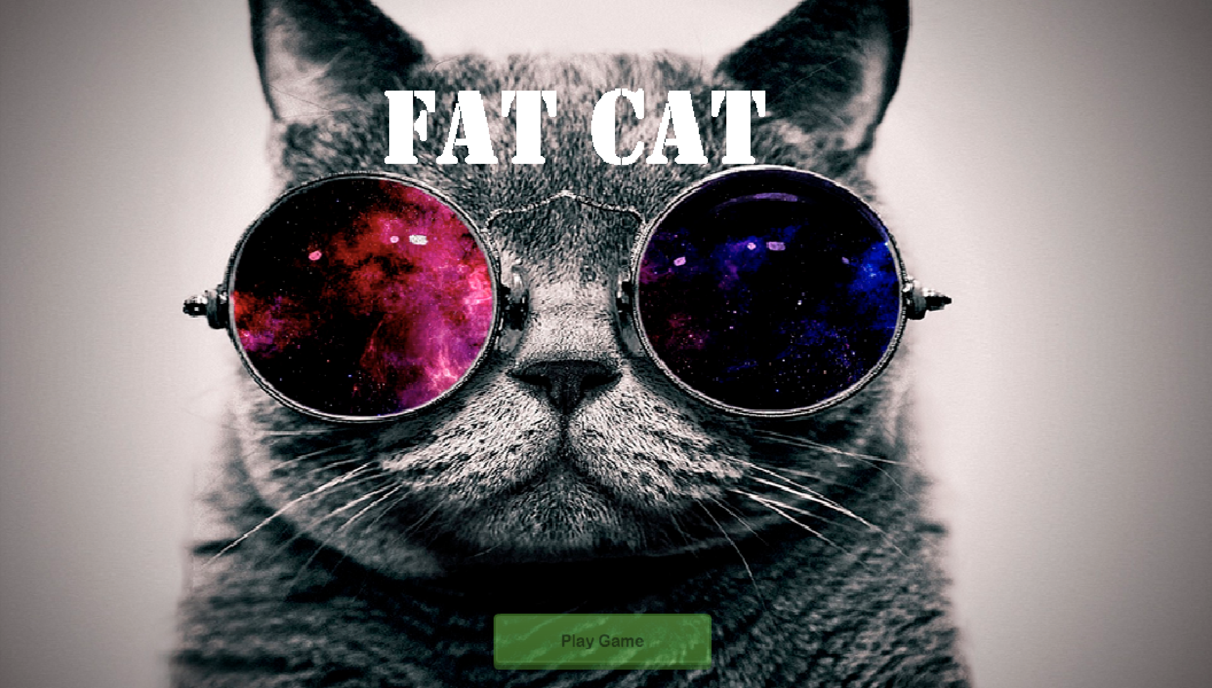

Slide 5
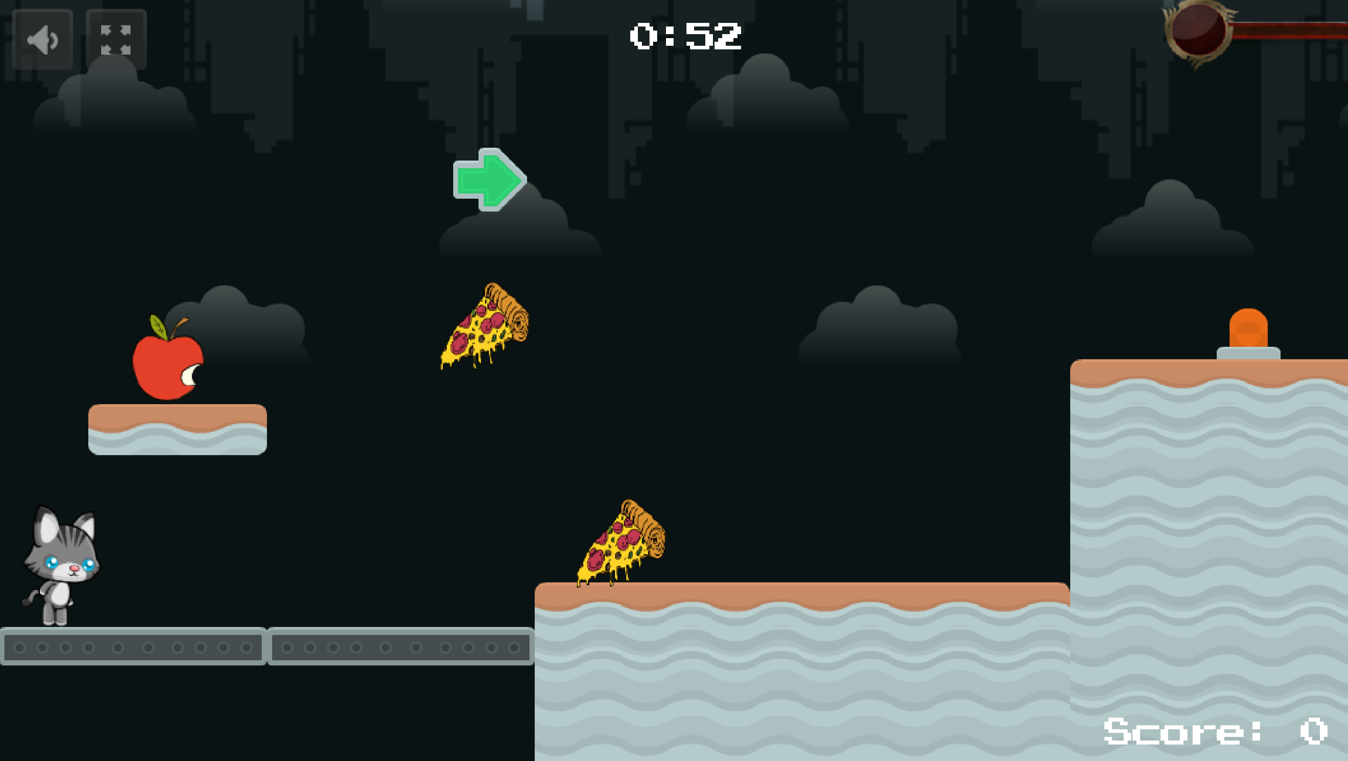
Healthy food item. Try to eat for better speed and more points!
Unhealthy food item. Try NOT to eat! Results in lower score and slower speed.

Slide 6
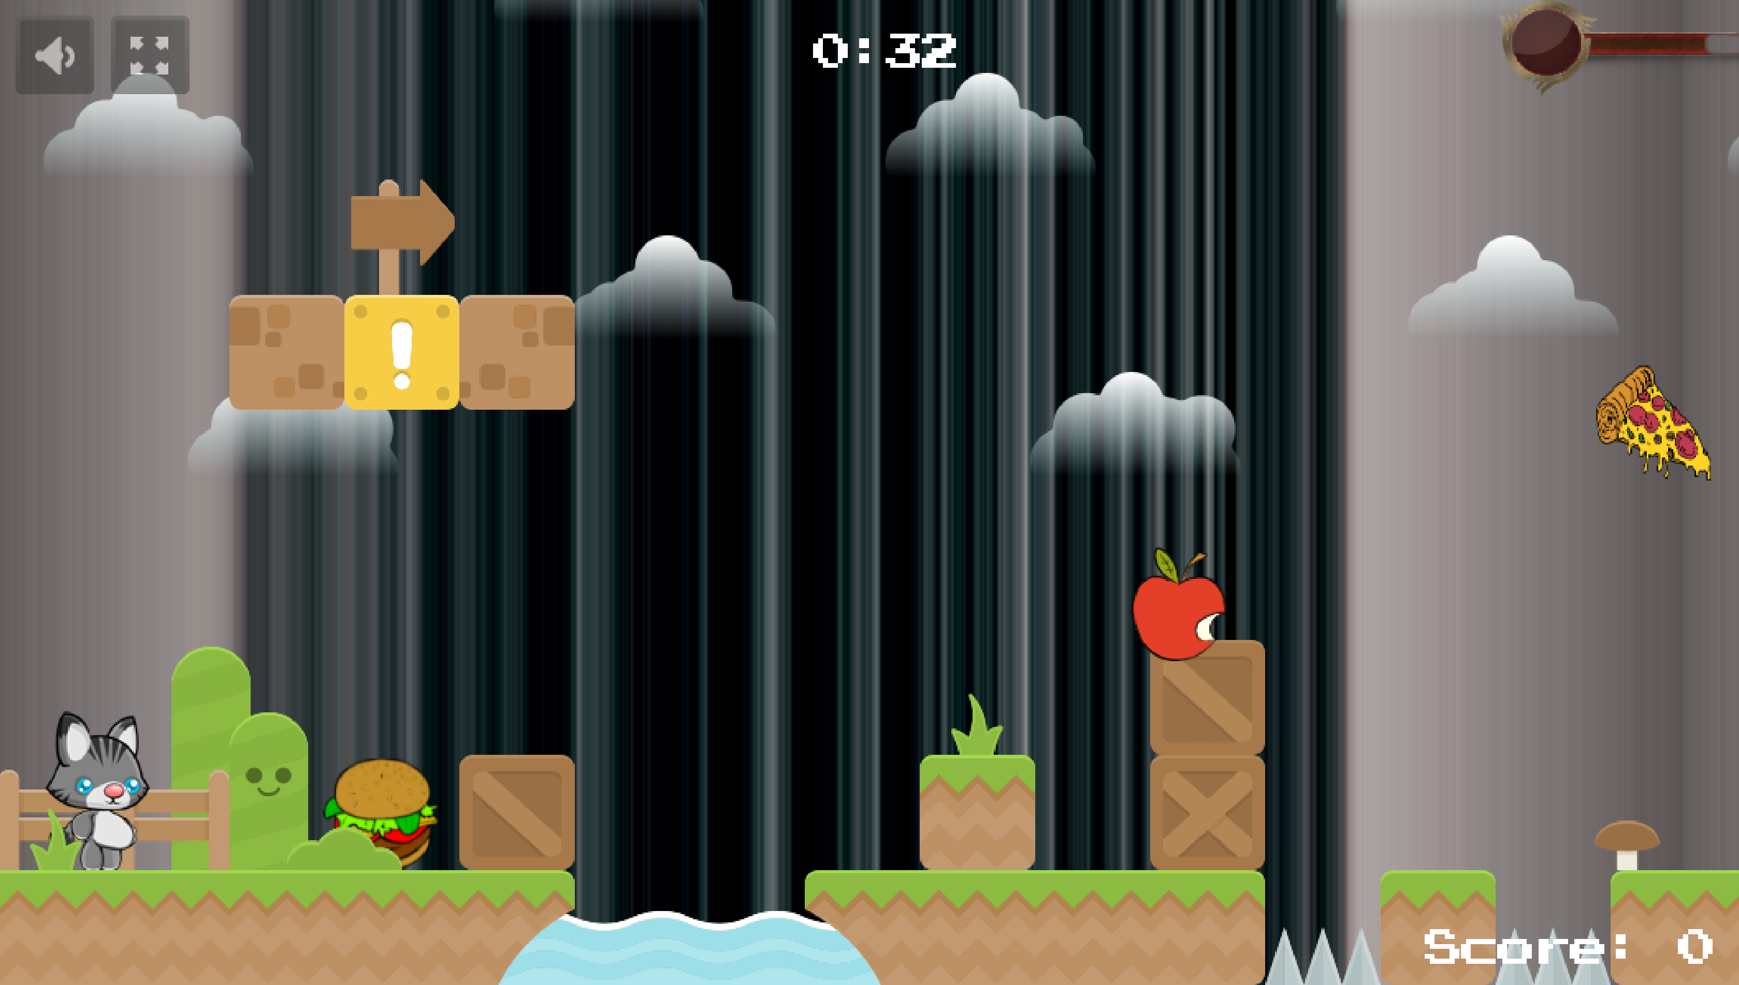
Health bar is lowered as more unhealthy items are eaten.
Cat appears with a larger belly to depict unhealthiness.

Slide 7
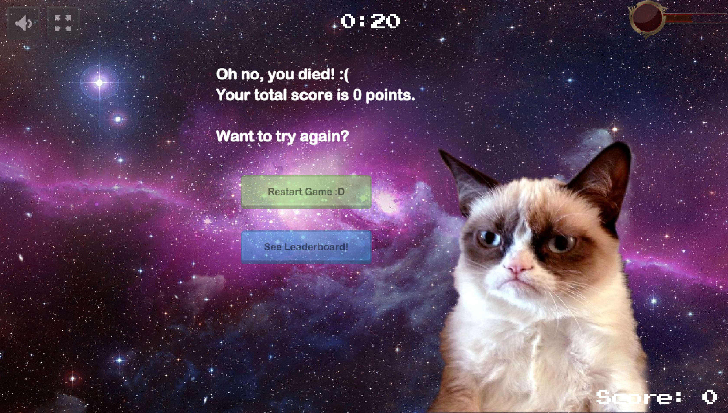

Slide 8
Live demo

Slide 9
Design patterns used
Decorator design pattern: For score calculation
Iterator design pattern: For displaying top 3 scores in our leaderboard
Command design pattern: For changing screens and updating states during screen changes
State design pattern: Used for state changes of main character
Factory design pattern: Used for UI or sprite object creation

Slide 10
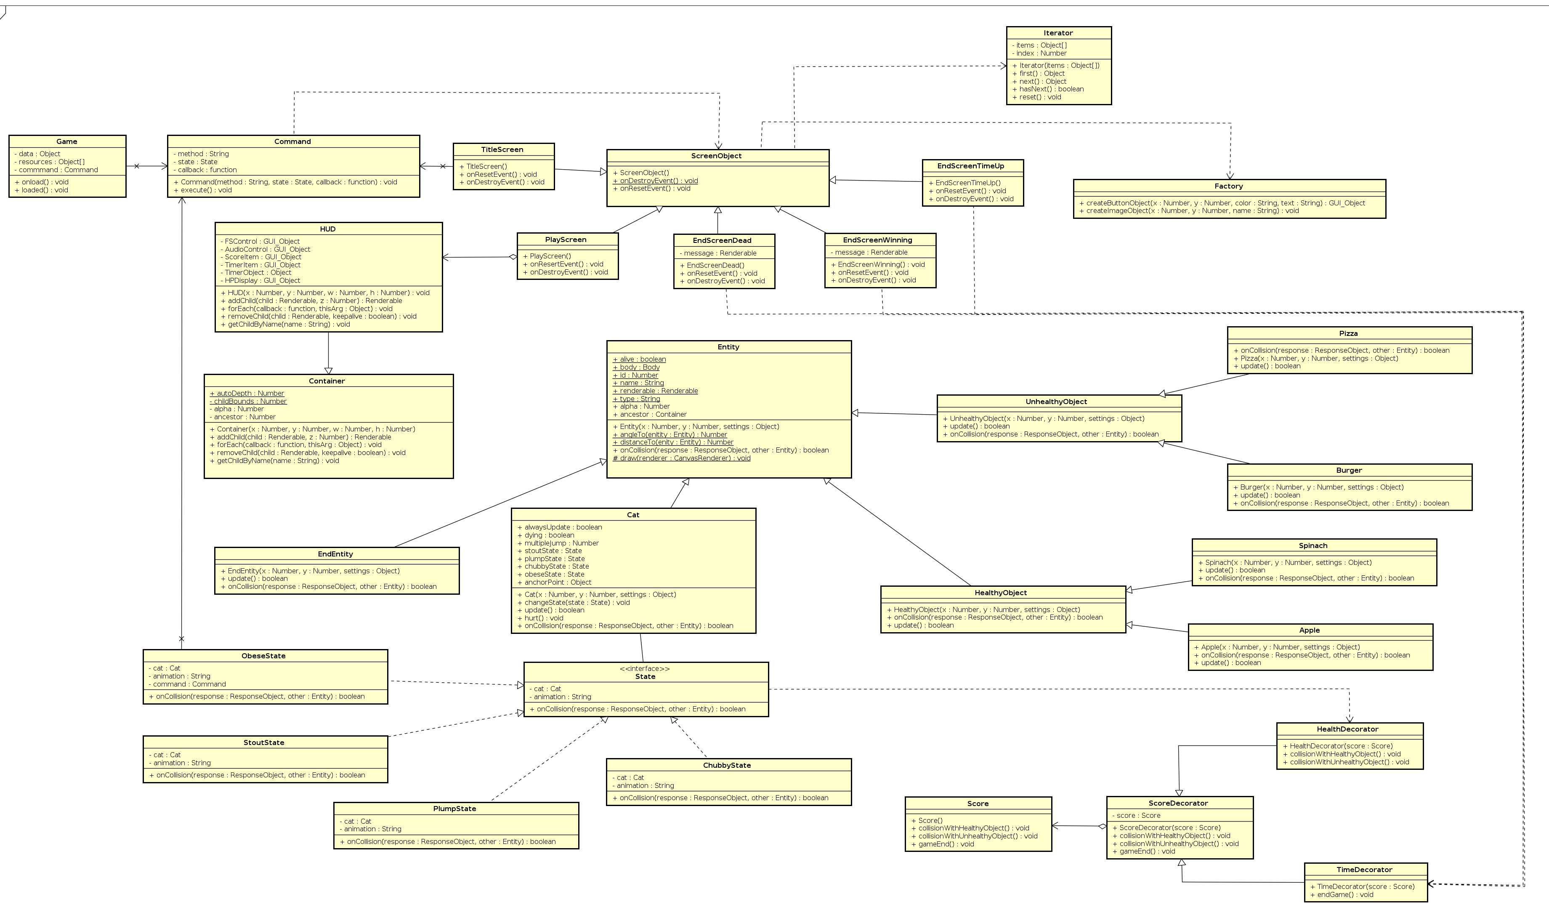
Class Diagram

Slide 11
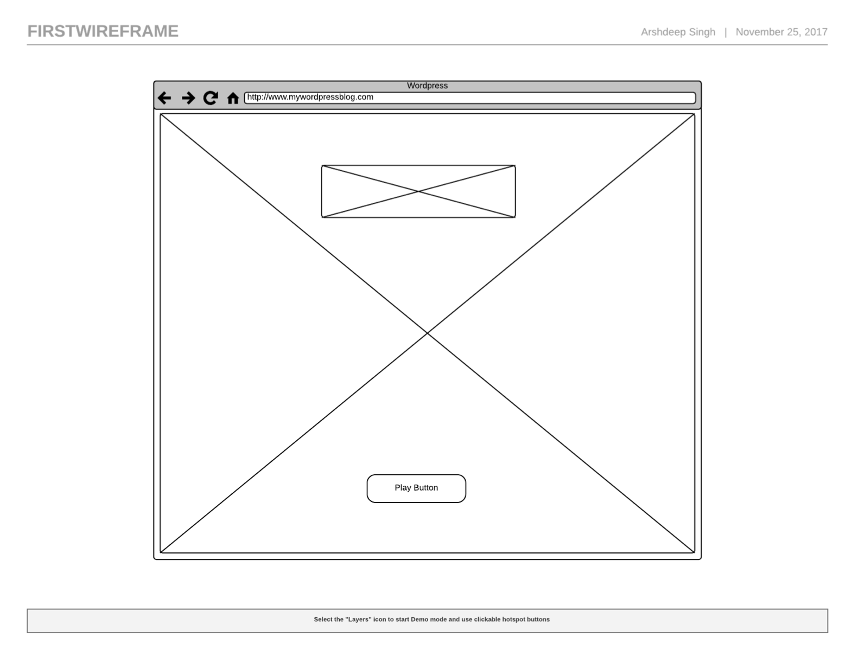
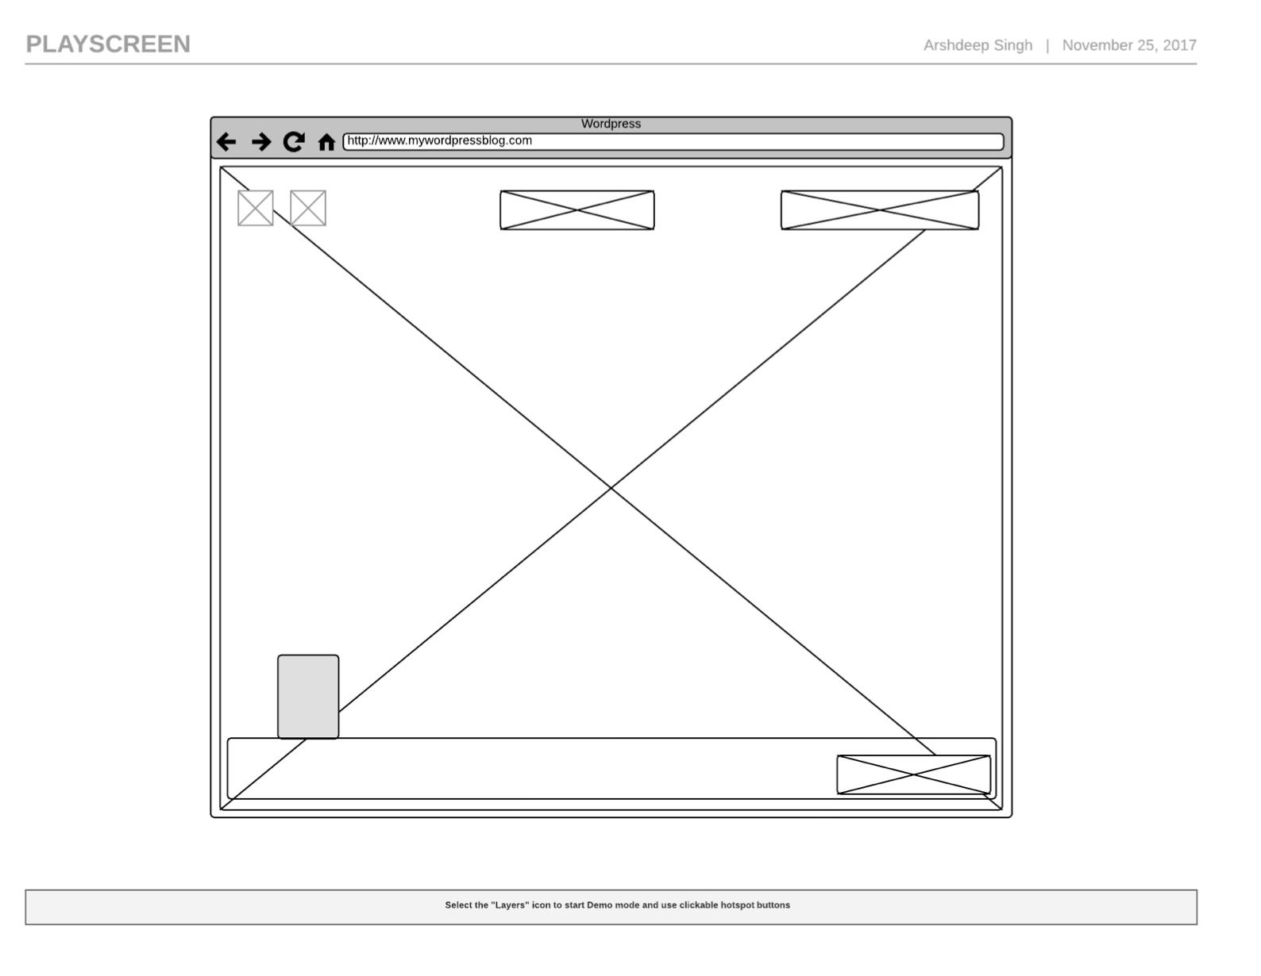
UI Wireframe

Slide 12
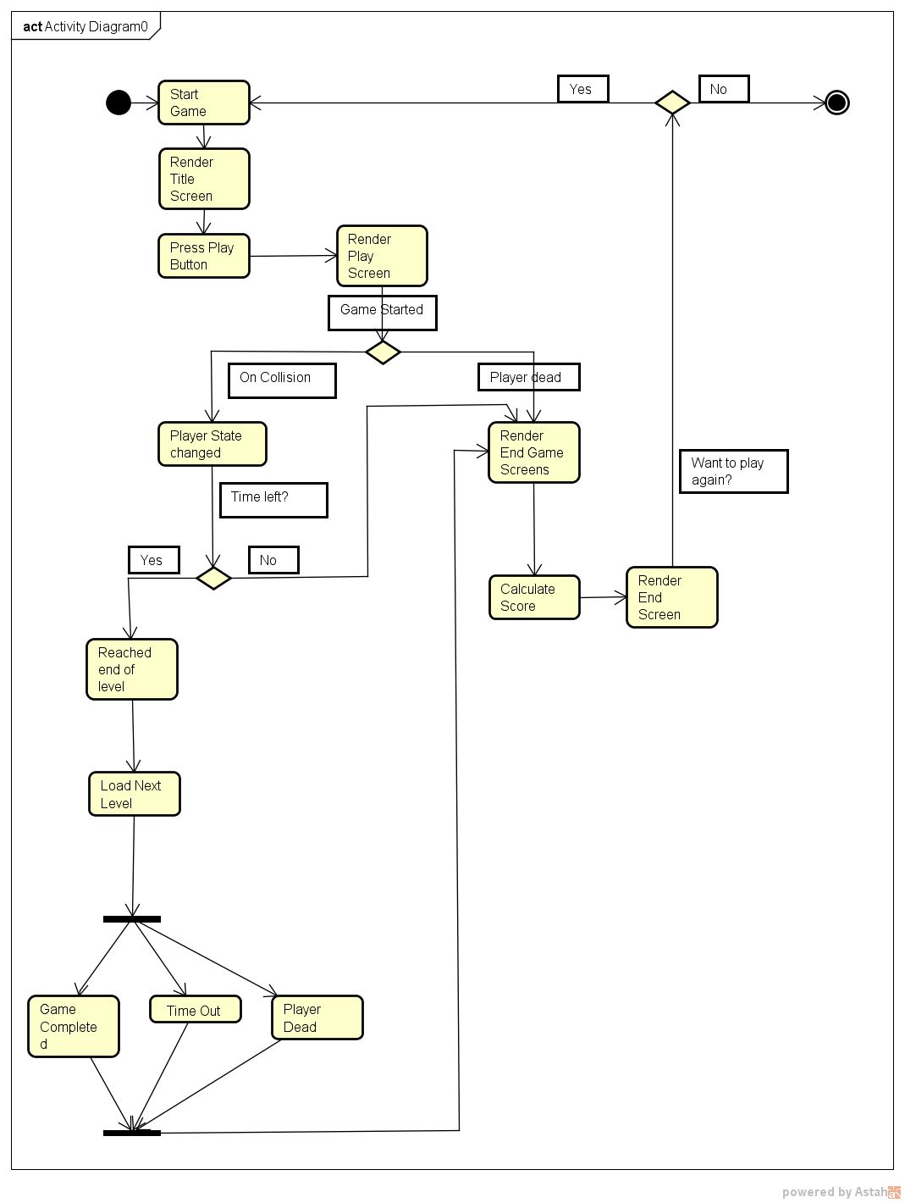
Activity Diagram

Slide 13
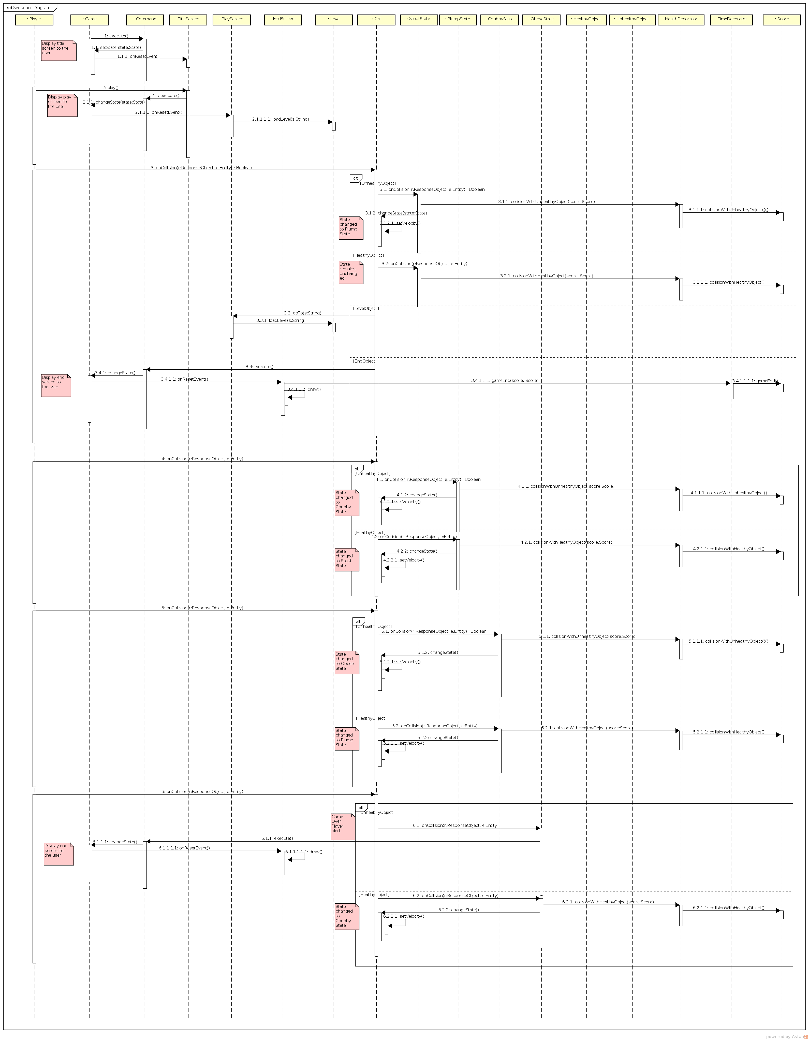
Design Sequence Diagram

Slide 14
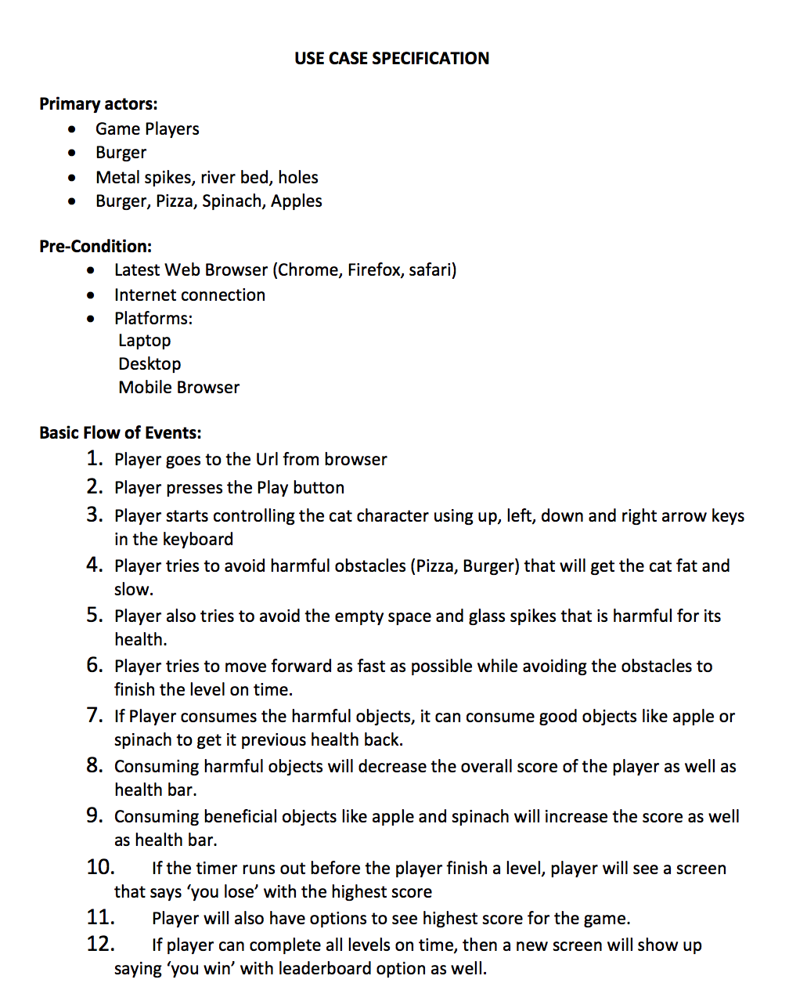
Use Case Specification

Slide 15
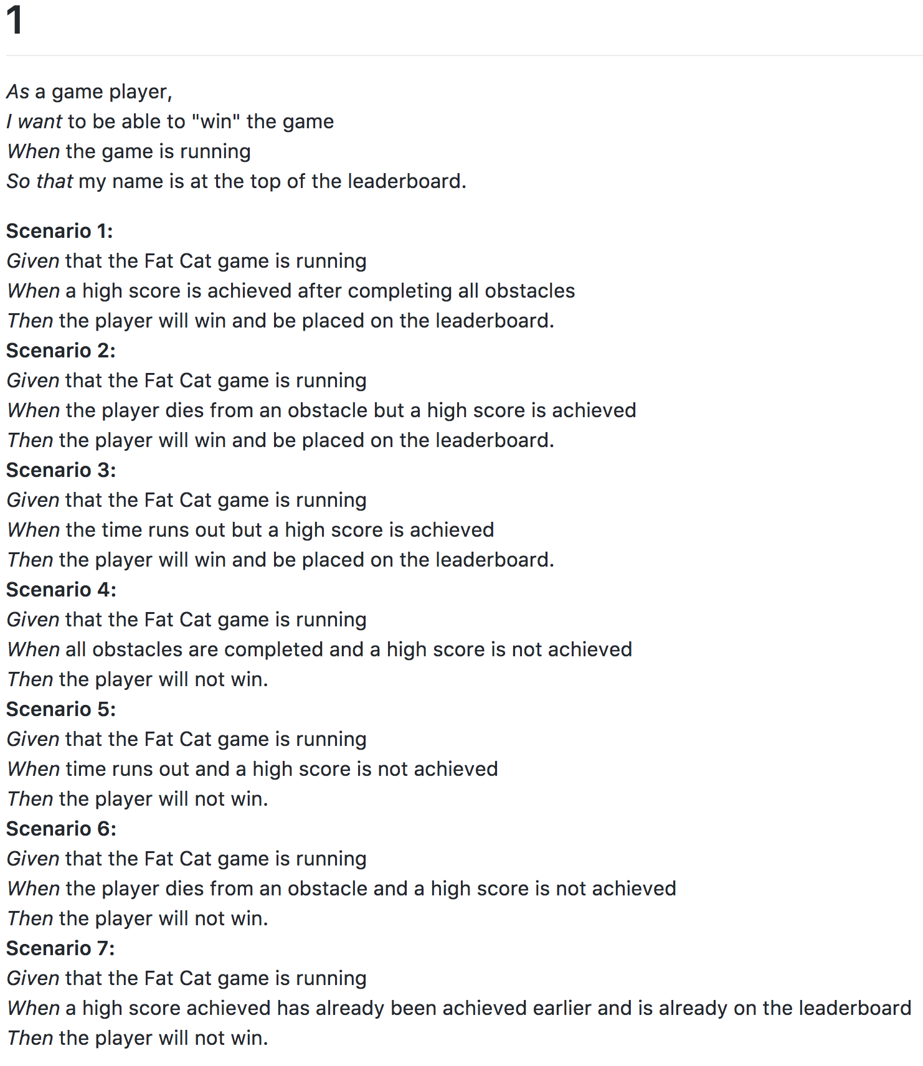
User Story
(additional stories available in GitHub repo)

Slide 16
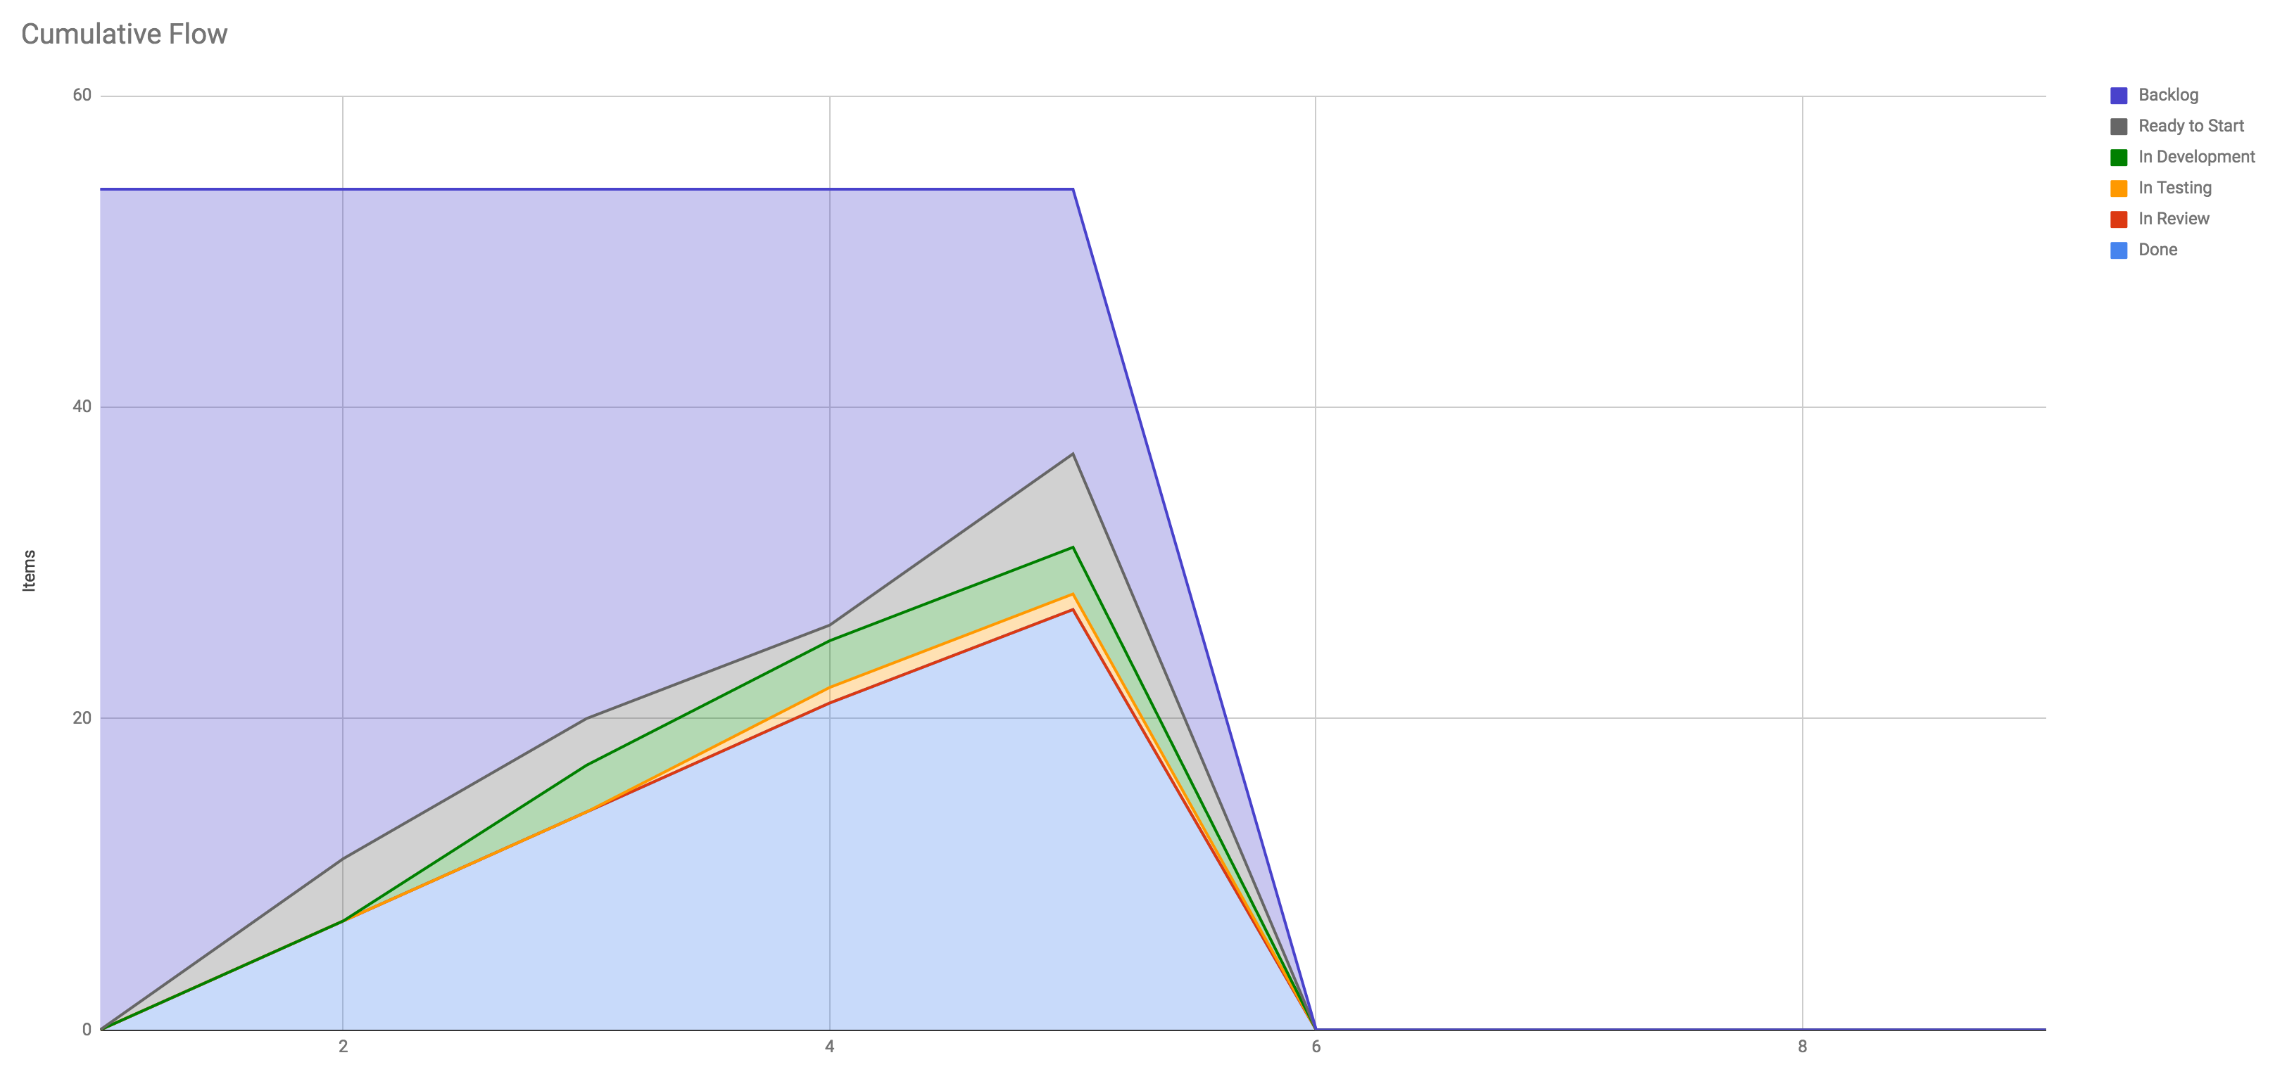
Kanban: Cumulative Flow Diagram

Slide 17
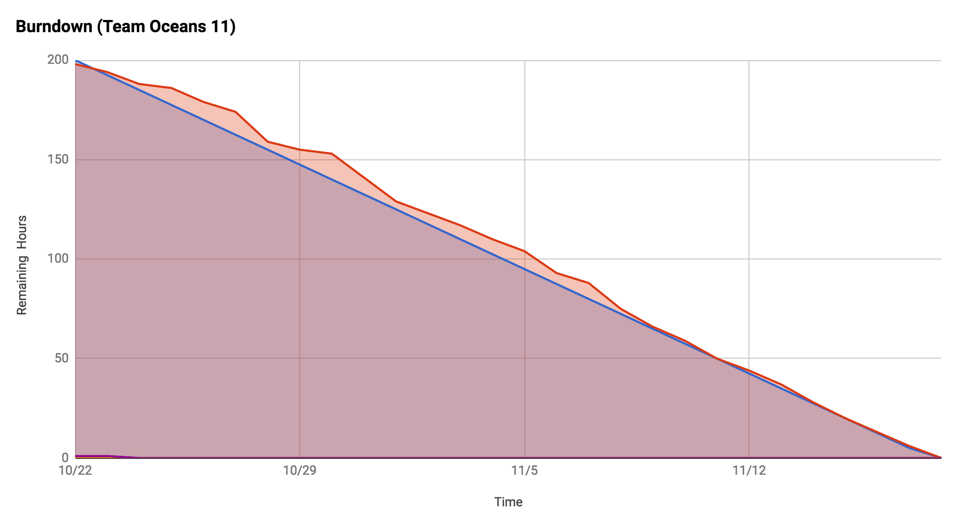
Scrum: Burndown Chart

Slide 18
Extra Credit Demo Video

Slide 19
Team retrospective: WHAT WE DID WELL
We believe the organization and structure of our project was executed well
Using Kanban, Scrum, and Agile methodologies, we were able to create tasks, assign tasks, and complete tasks within an allotted timeframe.
Were able to take large to-do items and split them into smaller tasks
Organized our project so that the first couple of weeks were for research, learning, and brainstorming: so that we could have a strong game plan set up for the development weeks thereafter
Weekly meetings allowed us to communicate about project issues and future project tasks + provide feedback to one another about current project status

Slide 20
Team retrospective: WHAT WE could have improved on
We believe we can improve in future development by having more specific backlog items
Allow for better project integration and testing throughout the week
For future development, this will be vital since each project component will be more complex and harder to test and integrate unless testing is done for every small component
Breaking each backlog item into even smaller items would help detect errors and issues earlier on and would help make the development process faster

Slide 21
Team retrospective: Future work
Adding more levels of difficulty to the game with increasing complexities
Add an option to select different characters within the game, each with different special attributes or abilities
Such as a tiger that can regenerate its health or a lion that starts off with higher health than normal
Add new objects and obstacles to the game
Different "healthy" and "unhealthy" objects
Other objects that would have different and special properties (i.e. an orange which gives the character 2x health or speed once consumed)
Will make the game more engaging and challenging

Slide 22
Run on our game on localhost
1. Clone our git repository.
2. Download and install MelonJS
3. Using the command line, enter the directory where the game is cloned.
4. Run "git serve" and open http://localhost:8000/ in your browser.

Slide 23
Thank you!

